Slide 1
Deriving Strategy Pattern
... derived from the principles

Slide 2
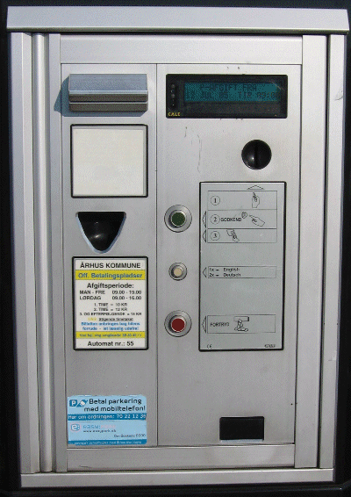
Last – Alphatown county
Customer – Alphatown county:
The pay station must:
  accept coins for payment
  show time bought
  print parking time receipts
  US: 2 minutes cost 5 cent
  handle buy and cancel
  maintenance (empty it)
CS @ AU
Henrik Bærbak Christensen

Slide 3

The nightmare: Success!
The Alphatown county is very satisfied!
Success is terrible!
It means:
New requirements, add-ons, special cases and “wouldn’t it be nice if...”
So – our parking machine software is now required by the Betatown county – but with a twist ☹
CS @ AU
Henrik Bærbak Christensen

Slide 4
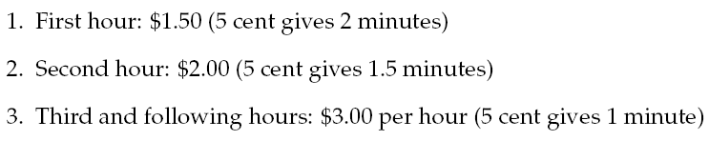
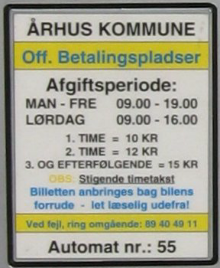
New requirement
Betatown:
Maybe we will see future changes
in pricing models ???
How can we handle these two products?
“New progressive price model”
CS @ AU
Henrik Bærbak Christensen

Slide 5
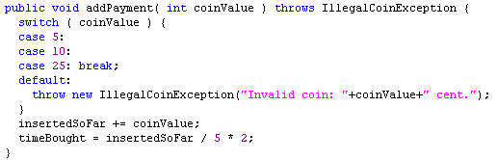
The present code
This is the spot where things may change: variability point
CS @ AU
Henrik Bærbak Christensen

Slide 6

Exercise !
Propose some models to handle this.
Consider:
  Most of the code is the same in the two products
  What about real success? 20 product variants?
Focus:
  Sketch several models, not just an
  “optimal” one.
  Read the book? Find a fifth model!
CS @ AU
Henrik Bærbak Christensen

Slide 7
Analysis
Model 1:
  Make a copy of the source tree
  Throw away some code, add some new code
  Throw away unit tests, add new unit tests
Model 2:
  Parameterization: Throw in some ‘if’-statements
Model 3:
  Polymorphic proposal: Variation through inheritance
Model 4:
  Compositional proposal: Factor out rate model responsibility
CS @ AU
Henrik Bærbak Christensen

Slide 8
Model 1: Source Code Copy
Widely used: Next generation software

Slide 9
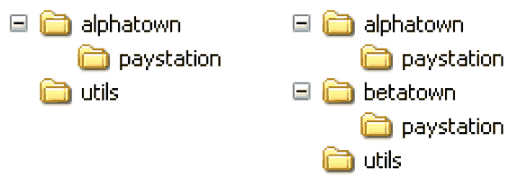
Model 1: Source tree copying
Idea: Deep copy production code source tree
Code the new variant by replacing the code at the variability point.
CS @ AU
Henrik Bærbak Christensen

Slide 10
Benefits
Benefits:
  It is simple!
    no special skill set required in developer team
    easy to explain idea to new developers
  It is fast!
    < 5 minutes?
  It provides perfect variant decoupling
    defects introduced in variant 2 does not reduce reliability of variant 1
    easy to distinguish variants (consult folder hierarchy)
CS @ AU
Henrik Bærbak Christensen

Slide 11
Liabilities
Liabilities:
Multiple maintenance problem 
  Changes in common code must be propagated to all copies
  Usually manual process (or tedious SCM operation)
Example:
  4 pay station variants (different rate policies)
  request: pay station keeps track of earning ☹
Experience: Variants drift apart, becoming different products instead of variants...
CS @ AU
Henrik Bærbak Christensen

Slide 12
Liabilities
If you have many copies you easily get mixed up
  thus the benefit of easily identifying which variant you are working on is actually not true
Example:
  Fixing the same bug in 5 nearly identical SAVOS production code bases at the same time ☹
CS @ AU
Henrik Bærbak Christensen

Slide 13
Model 2: Parametric Solution
Widely used: Debug variant

Slide 14

Parametric
Idea:
  It is only a single “behavioural unit” in the addPayment method that varies
  I can simply make a conditional statement there
A) Introduce a parameter (Which town)
B) Switch on the parameter each time town specific behaviour is needed.
CS @ AU
Henrik Bærbak Christensen

Slide 15
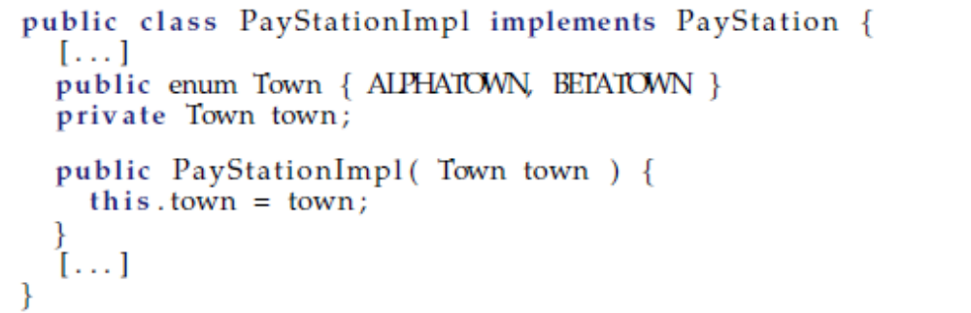
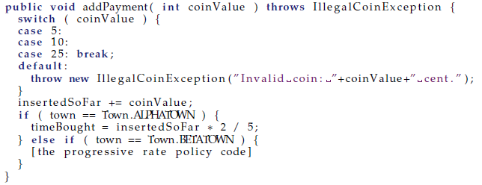
Code View
CS @ AU
Henrik Bærbak Christensen

Slide 16
Instantiation
PayStation ps =
new PayStationImpl( Town.ALPHATOWN );
CS @ AU
Henrik Bærbak Christensen

Slide 17
Benefits
Benefits:
  Simple
    A conditional statement is one of the first aspects learned by programmers, used widely, and thus easy to understand for any skill level developer team
  Avoid multiple maintenance problem
    Yeah!!! Common defects/requirements are handled once and for all.
CS @ AU
Henrik Bærbak Christensen

Slide 18
Liabilities
Liabilities:
  Reliability concerns
  Readability concerns
  Responsibility erosion
  Composition problem
CS @ AU
Henrik Bærbak Christensen

Slide 19
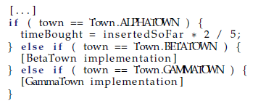
Analysis
Reliability/quality problem
  Each time we must add a new rate model (sell in a new town) we must add code to the existing PayStationImpl class.
  This means potential of introducing errors in old code.
  This means complete regression testing (and test case review) of all product variants!
  Change by modification is costly !!!
CS @ AU
Henrik Bærbak Christensen

Slide 20
Analysis
Reliability/quality problem
  Actually our pay station case is the easiest one!
  Consider a big system in which there are 83 places where we switch on the town parameter
    Or – was it 84 places ???
  Change by modification is costly !!!
CS @ AU
Henrik Bærbak Christensen

Slide 21
Analysis
Readability: Code bloat
  If we must handle 43 different price models, then the switching code becomes long and winding, and the original algorithm almost drowns...
Switch creep
  Throwing in “if” often leads to more “if”
if ( Town == ALPHATOWN ) {
if ( databaseServer == ORACLE && OptimizingOn ){
if ( DEBUG ) { Console.WriteLine( “...” ); }
...
} else { if ( IsMobilePayment() ) {
discountFactor = 0.9;
XXX
} else { ... }
Tell me what options are set in the XXX code ? Difficult, huh?
CS @ AU
Henrik Bærbak Christensen

Slide 22
Analysis
Responsibility erosion (“feature creep”)
  Let us review what the responsibilities of the pay station really are now:
<<interface>>
PayStation
Wait a few month and
the machine is also responsible for parsing XML files, printing
debug statements in the
console, updating a database, and handle transactions over mobile SMS network !
Responsibility
Accept payment
Handle transactions
Know time bought
Print recipt
Handle variations for Alphatown and Betatown
CS @ AU
Henrik Bærbak Christensen

Slide 23
Analysis
Composition problem
  A rate model that is a combination of existing ones leads to code duplication [can be avoided by making private methods in the class]
  Example of much worse situation will be dealt with later...
CS @ AU
Henrik Bærbak Christensen

Slide 24
Conditional compilation
In C and C++ you may alternatively use #ifdef’s
The analysis is basically the same as for parameterization, except that there is no performance penalty --- but choice of which model to be used cannot be made at run-time.
Note: Embedded software where memory footprint of code is important this may be the solution far superior to a pattern based solution!
CS @ AU
Henrik Bærbak Christensen

Slide 25
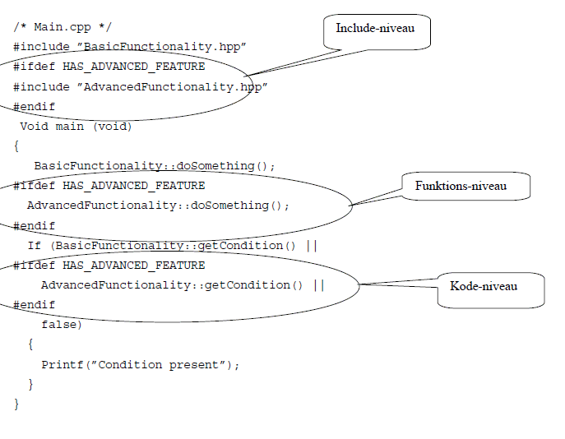

Example
CS @ AU
Henrik Bærbak Christensen

Slide 26
Example
Data from ”reality”
  600.000 lines of C++
    1.300 classes
    2.400 files
  60.000 staff-days for development
  3 sites of development
432 parameters (”compile-flags”) must be set to determine the specific variant of the product
  All defined in a make-file (~ build.xml)
CS @ AU
Henrik Bærbak Christensen

Slide 27
Model 2: Summary
It is tempting!
  it is easy - ½ minute in the editor, compile, done!
  the first ‘if’ is easy to overview, understand, and get correct
  but it should turn on the alarm bell !
CS @ AU
Henrik Bærbak Christensen

Slide 28
Model 3: Polymorphic Solution
The ‘better’ solution
for many years…
Give a man a hammer and the world will seem to consist purely of nails…

Slide 29

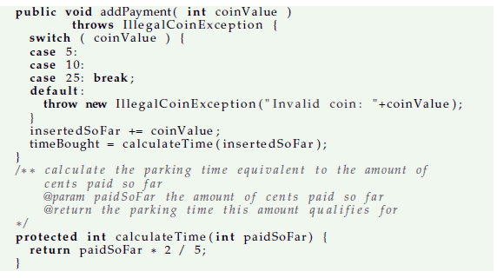
Model 3: Polymorphic proposal
Subclass and override!
CS @ AU
Henrik Bærbak Christensen

Slide 30
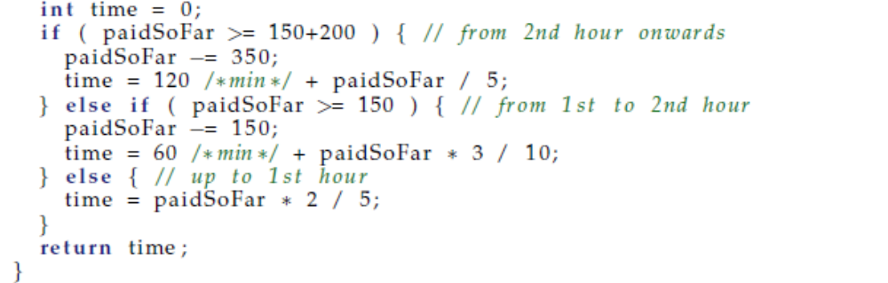
Proposal 3: Instantiation
Warning: C# ahead
Functionality selection + implementation:
public class PayStationProgressivePrice : PayStationImpl {
public PayStationProgressivePrice() : base() {}
override protected int calculateTime(int insertedSoFar) {
}
Instantiation:
PayStation ps_subclass =
new PayStationProgressivePrice();
CS @ AU
Henrik Bærbak Christensen

Slide 31
Analysis
Benefits
  Avoid multiple maintenance
  Reliability concern
  Code readability
Liabilities
  Increased number of classes
  Inheritance relation spent on single variation type
  Reuse across variants difficult
  Compile-time binding
CS @ AU
Henrik Bærbak Christensen

Slide 32
Benefits
☺ Reliability concern
  The first time I add a new rate policy I change by modification!
    I have to refactor the code to introduce the new private method calculateTime
But
  All following new requirements regarding rate policies can be handled by adding new subclasses, not by modifying existing classes.
  Thus, no fear of introducing defects in existing software; no regression testing, no reviews.
Change by addition, not by modification
CS @ AU
Henrik Bærbak Christensen

Slide 33
Benefits
☺ Readability
  There is no code bloating from introduction conditional statements
  I simply add new classes instead
CS @ AU
Henrik Bærbak Christensen

Slide 34
Liabilities
☹ Increased number of classes
  I have to add one new class for each rate policy variant
  thus instead of 43 if statements in one class I get 43 subclasses to overview
CS @ AU
Henrik Bærbak Christensen

Slide 35
Liabilities
☹ Spent inheritance on single variation type
  You have “wasted” your single implementation-inheritance capability on one type of variation!
    The name is odd – isn’t it?
    “PayStationProgressivePrice”
    What is next:
    “PayStationProgressivePriceButLiniarInWeekendsWithOracleDataBaseAccessDebuggingVersionAndBothCoinAndMobilePhonePaymentOptions” ???
  We will discuss this problem in detail later...
CS @ AU
Henrik Bærbak Christensen

Slide 36
Liabilities
☹ Inheritance is a compile time binding
  Inheritance is a compile time binding !!!
    you literally write “extends / :” in your editor !!!
  Thus you cannot change rate model except by rewriting code!
    Sorts of similar to “change by modification ☺”
  And it is completely impossible to dynamically change rate policy at run-time or at start-up time.
CS @ AU
Henrik Bærbak Christensen

Slide 37
Liabilities
☹ Reuse across variants is difficult
  Gammatown
    “We want a rate policy similar to Alphatown during weekdays but similar to Betatown during weekends.”
  but some code is in one superclass and some in another subclass...
  combining them will lead to a pretty odd design
  or I have to refactor into an abstract superclass that contains the rate policies... But what do they do there?
CS @ AU
Henrik Bærbak Christensen

Slide 38
Model 5: Generative Solution
The masked ‘source code copy’ approach

Slide 39
Weaving
Source code divided into
  Template code with “holes”
  Code fragments that fit the holes
    A set defined by the fragments that define a variant
Weaving
  Merge(template, fragment set) => source
Now you can compile the variant source code.
Example: FMPP used in generating source code for the book in two variants: download or in-book listings
CS @ AU
Henrik Bærbak Christensen

Slide 40
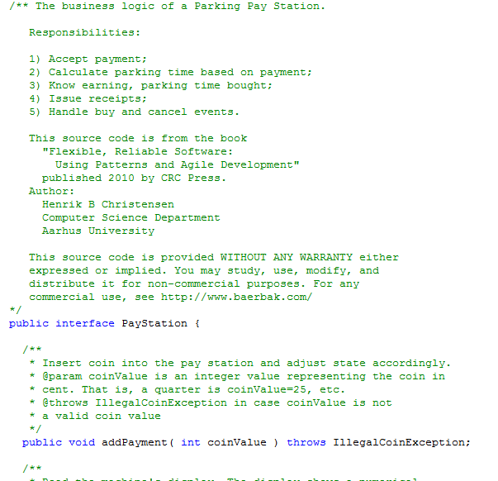
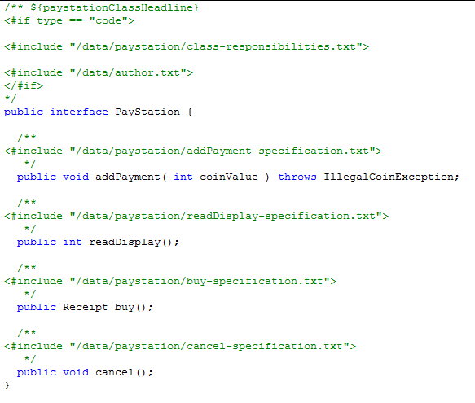
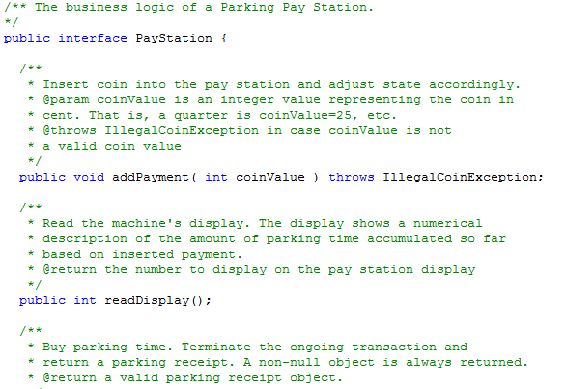
Example: PayStation.java
A ”hole”
CS @ AU
Henrik Bærbak Christensen

Slide 41
Weaving
Examples
  Maven archetype
  AspectJ – aspect oriented programming
  FMPP that handles aspects of my book’s code
  And for those with white beards ☺
    Beta fragment system
    Trine’s slots
CS @ AU
Henrik Bærbak Christensen

Slide 42
My experience
This type systems pops up again and again
  Maven archtype is the newest I know of…
It is basically source-code-copy over again
  But with some tooling support to avoid multiple maintenance problem
However
  It stinks! Why?
  Because the executing code differs from what I see in my editor!
    We short-circuit our power of reasoning => BUGS!
  Morale: Avoid it if possible…
  But it is not always possible.
    I use it for my book’s code – I have no other option (except manual source code copy – yikes…)
CS @ AU
Henrik Bærbak Christensen

Slide 43
Model 4: Compositional Solution
A fresh and new look at the problem

Slide 44
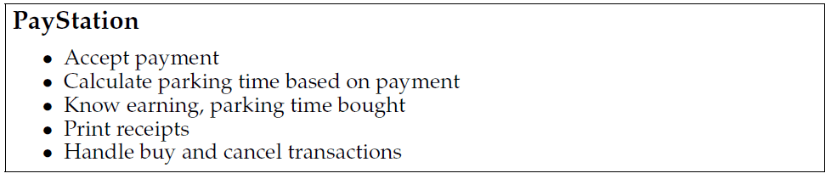
Proposal 4: Composition
Golden rule: No abstraction should have too many responsibilities. Max 3 is a good rule of thumb…
(Facade objects are an exception)
CS @ AU
Henrik Bærbak Christensen

Slide 45
Serving too many responsibilities
The reason that we have to modify code to handle the new requirement instead of adding code is because
The change revolves around a responsibility (calculate parking time) that is buried within an abstraction and mixed up with many other responsibilities (print receipt, handle buy, etc.) !!!
So: What do we do???
CS @ AU
Henrik Bærbak Christensen

Slide 46
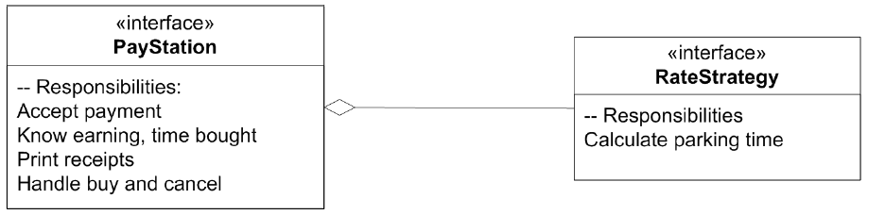
Divide responsibilities - compose them
A proposal is simply to
Put the responsibility in its own abstraction / object
CS @ AU
Henrik Bærbak Christensen

Slide 47
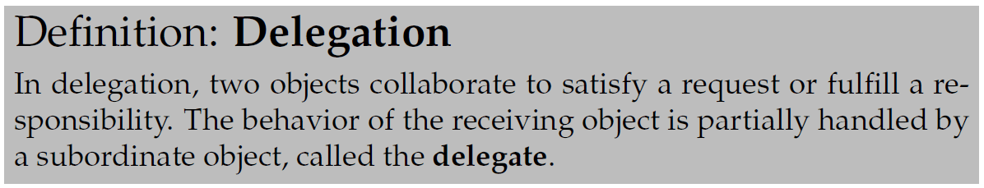
Delegation
The basic principle is simple but powerful:
  Instead of one object doing it all by itself, it asks another object to help out. Some of the job is handled by another “actor” – the delegate
This principle has a name:
CS @ AU
Henrik Bærbak Christensen

Slide 48
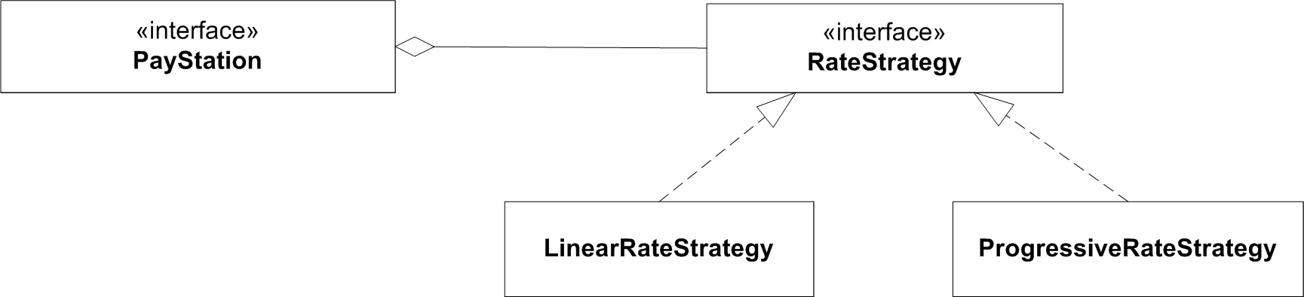
Concrete behaviours
Responsibilities must be served by concrete behaviour in objects...
CS @ AU
Henrik Bærbak Christensen

Slide 49
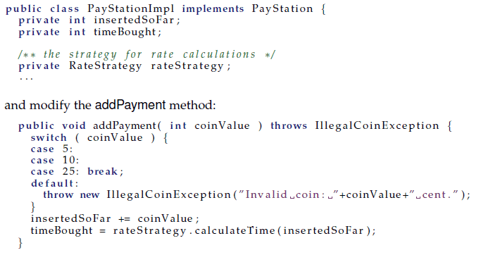
Code View
CS @ AU
Henrik Bærbak Christensen

Slide 50
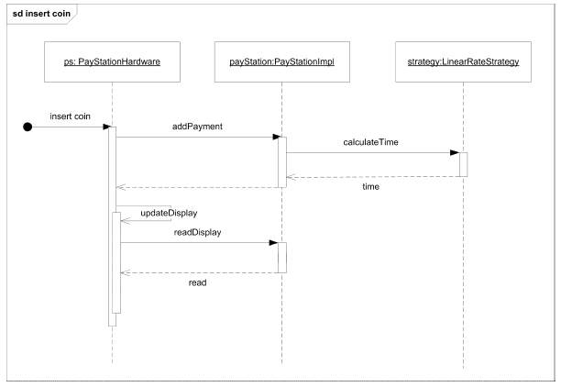
Behaviour
CS @ AU
Henrik Bærbak Christensen

Slide 51
Exercise
The pay station needs to know which rate strategy object to use, of course!
How do we tell it ???
CS @ AU
Henrik Bærbak Christensen

Slide 52
Choosing pricing
Warning: C# ahead
Several possibilities
  Constructor
  Set-method
  Creational patterns (later on☺)
Functionality selection:
// The rate calculation strategy used
RateStrategy rateStrategy;
public PayStationImpl( RateStrategy rs ) : base() {
rateStrategy = rs;
}
CS @ AU
Henrik Bærbak Christensen

Slide 53
Exercise
What are the benefits and liabilities of
  Using the constructor to define the strategy?
  Using a set-method to define the strategy?
CS @ AU
Henrik Bærbak Christensen

Slide 54
Analysis
Constructor
  Compiler will tell you that you have forgotten to make it!
    Much less cost than letting the customer find out !!!
  Early binding that cannot be changed at run-time
Set-method
  You will forget to set it !!!
  ... but you can change your mind at run-time !
    (at least for stateless objects like strategy objects...)
CS @ AU
Henrik Bærbak Christensen

Slide 55
Analysis
Benefits
  Readability
  Run-time binding
  Separation of responsibilities
  Variant selection is localized
  Combinatorial
Liabilities
  Increased number of interfaces, objects
  Clients must be aware of strategies
CS @ AU
Henrik Bærbak Christensen

Slide 56
Analysis
☺ Readability
  no code bloat of conditional statements
☺ Run-time binding
  I can actually change the rate policy while the system is running. Leads to lower maintenance costs as no shut down required
CS @ AU
Henrik Bærbak Christensen

Slide 57
Benefits
☺ Responsibilities clearly stated in interfaces
  Leads to No Odd Naming:
  PayStation and RateStrategy: The responsibilities
  LinearRateStrategy ect: Concrete behaviour fulfilling responsibilities
  The pay station has “lost some fat”
    by separating responsibilities the cohesion of the code within each abstraction is higher
    Note though that from the GUI/hardware’s perspective, the pay station still has the ‘formal’ responsibility to calculate rates!
CS @ AU
Henrik Bærbak Christensen

Slide 58
Benefits
☺ Variant selection localized
  There is only one place in the code where I decide which rate policy to take
    namely in the configuration/main code where I instantiate the pay station!
  contrast to the parametric solution where selection and decision code is smeared all over the place
  No variant handling code at all in the pay station code !
CS @ AU
Henrik Bærbak Christensen

Slide 59
Benefits
☺ Combinatorial
  I have not used inheritance – we can still subclass it to provide new behavior on other aspects – without interfering with the rate calculation!
  But – much more on that later...
CS @ AU
Henrik Bærbak Christensen

Slide 60
The 3-1-2 process

Slide 61
So – Pizza from the ingredients ☺
③ We have identified some behaviour that is likely to change…
  rate policies
① We have clearly stated a responsibility that covers this behaviour and expressed it in an interface:
② The parking machine now perform rate calculations by letting a delegate object do it: the RateStrategy object.
  time = rateStrategy.calculateTime(amount);
<<interface>>
RateStrategy
-- Calculate Parkingtime
CS @ AU
Henrik Bærbak Christensen

Slide 62
The 3-1-2 process
I call this “mini-process” of handling variability for the 3-1-2 process
The reason for the odd numbering is its relations to the principles of flexible design that are put forward in the Design Pattern book (GoF) by Gamma et al.
The number refer to the sequence in the GoF book that the principle is mentioned.
CS @ AU
Henrik Bærbak Christensen

Slide 63
Transferring responsibilities
Actually this is a common thing in everyday life
Some years ago I transferred the responsibility to empty the garbage can to my eldest son
  (not without some heated arguments though ☺)
Project leaders’ main responsibility is – to delegate responsibility to other people
And why? Because A) we cannot do everything ourselves and B) too many responsibilities leads to stress and errors!
CS @ AU
Henrik Bærbak Christensen

Slide 64
Key technique: Delegation
In software this simple technique ”let someone else do the dirty job” is called delegation.
Instead of an object doing it itself:
  time = this.calculateTime(amount);
  this.takeGarbageToGarbageCan();
we let some specialist object do it for us:
  time = priceStrategy.calculateTime(amount);
  son.takeGarbageToGarbageCan();
CS @ AU
Henrik Bærbak Christensen

Slide 65
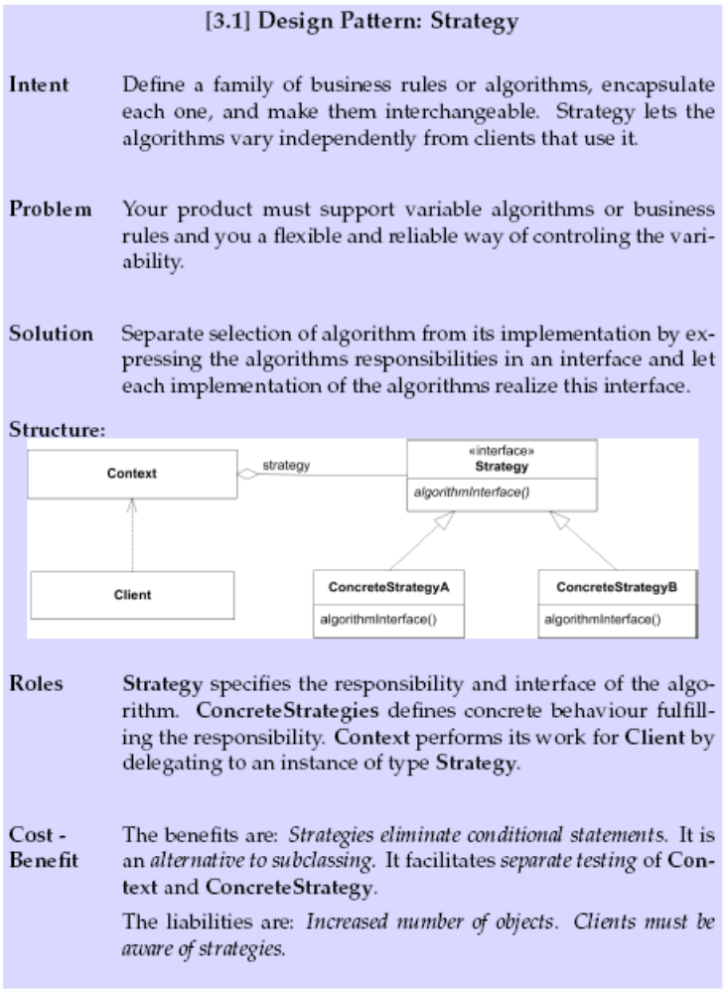
Conclusion
We have derived
the strategy pattern
by analysing
our problem in a
certain way!
CS @ AU
Henrik Bærbak Christensen

Slide 66
Consequences (GoF)
Families of related algorithms. Hierarchies of Strategy classes define a family of algorithms or behaviors for contexts to reuse. Inheritance can help factor out common functionality of the algorithms.
An alternative to subclassing. Inheritance offers another way to support a variety of algorithms or behaviors. You can subclass a Context class directly to give it different behaviors. But this hard-wires the behavior into Context. It mixes the algorithm implementation with Context's, making Context harder to understand, maintain, and extend. And you can't vary the algorithm dynamically. You wind up with many related classes whose only difference is the algorithm or behavior they employ. Encapsulating the algorithm in separate Strategy classes lets you vary the algorithm independently of its context, making it easier to switch, understand, and extend.
Strategies eliminate conditional statements. The Strategy pattern offers an alternative to conditional statements for selecting desired behavior. When different behaviors are lumped into one class, it's hard to avoid using conditional statements to select the right behavior. Encapsulating the behavior in separate Strategy classes eliminates these conditional statements. Code containing many conditional statements often indicates the need to apply the Strategy pattern.
CS @ AU
Henrik Bærbak Christensen

Slide 67
Consequences (GoF)
A choice of implementations. Strategies can provide different implementations of the same behavior. The client can choose among strategies with different time and space trade-offs.
Clients must be aware of different Strategies. The pattern has a potential drawback in that a client must understand how Strategies differ before it can select the appropriate one. Clients might be exposed to implementation issues. Therefore you should use the Strategy pattern only when the variation in behavior is relevant to clients.
Communication overhead between Strategy and Context. The Strategy interface is shared by all ConcreteStrategy classes whether the algorithms they implement are trivial or complex. Hence it's likely that some ConcreteStrategies won't use all the information passed to them through this interface; simple ConcreteStrategies may use none of it! That means there will be times when the context creates and initializes parameters that never get used. If this is an issue, then you'll need tighter coupling between Strategy and Context.
Increased number of objects. Strategies increase the number of objects in an application. Sometimes you can reduce this overhead by implementing strategies as stateless objects that contexts can share. Any residual state is maintained by the context, which passes it in each request to the Strategy object. Shared strategies should not maintain state across invocations. The Flyweight (195) pattern describes this approach in more detail.
CS @ AU
Henrik Bærbak Christensen

Slide 68
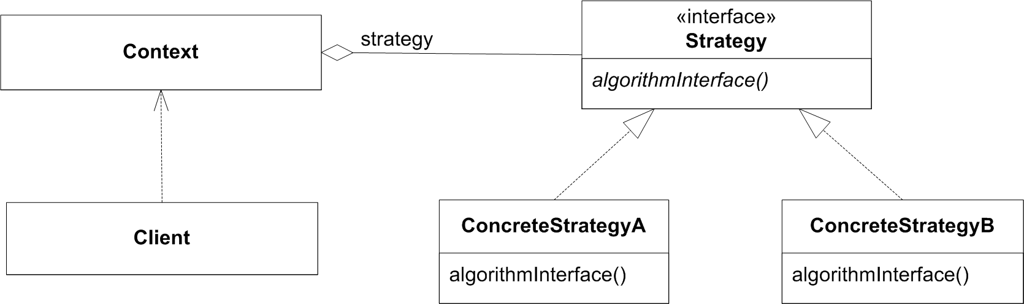
Terminology
Strategy defines three roles:
Client, Context and Strategy
CS @ AU
Henrik Bærbak Christensen

Slide 69
Summary
From the ingredients
  ③ identified behaviour likely to change
  ① express responsibility for behaviour as interfaces
  ② use delegation to support behaviour
we have derived a pattern automagically ☺
This is the nuts and bolts for most (behavioural) patterns !
CS @ AU
Henrik Bærbak Christensen

